Slide 1
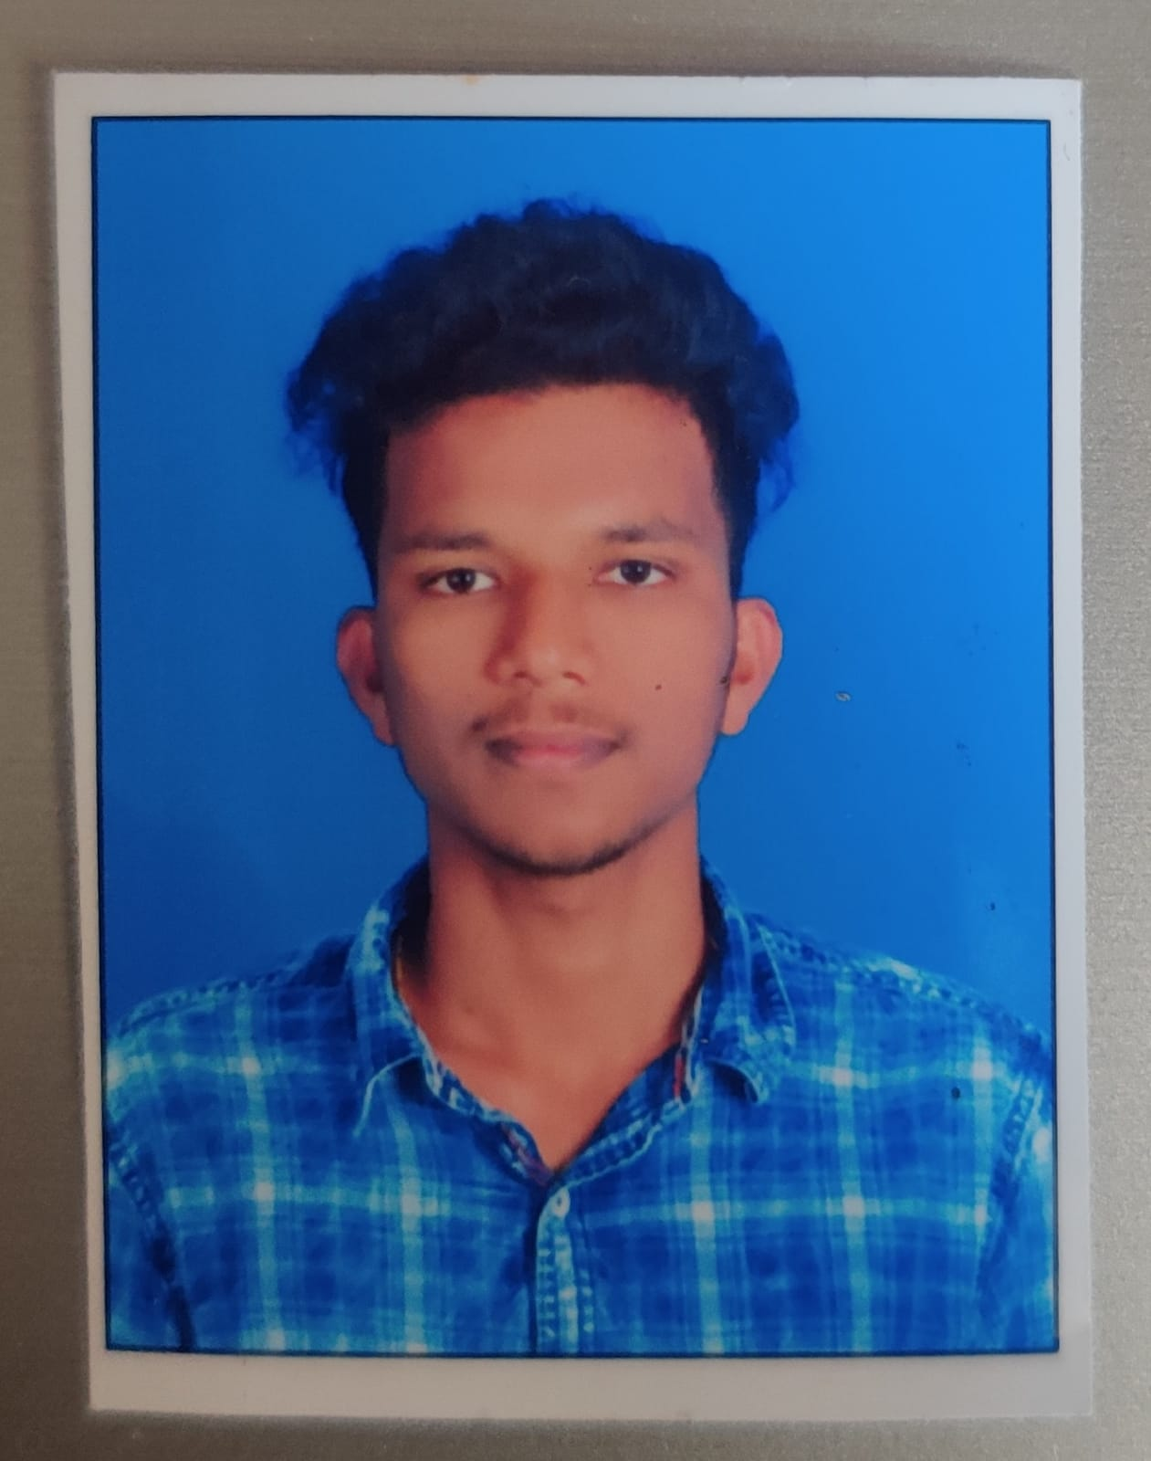



KONDA NAVEEN
Analyst/Software Engineer
Bachelor of Technology
APPLICATIONS (B.tech) : 2017- 2021
Skills
Java 8 /J2EE | Java Basics, OOPS, Generics, Collections, Arrays, Loops, Lambda Exp, Stream API Junit, Mockito, Servlets
Spring core | IOC & Dependency Injection, Autowire
Spring REST | REST controllers, Implementation of GET, POST, PUT & DELETE, Bean Validation & Exception Handling, Testing Services, Controller & Rest template
Spring Boot Microservices | Spring Boot Starters, annotations, Messaging Service, Sync/Async comms, Swagger API documents
Spring Cloud | Eureka, Netflix Ribbon, Netflix Hystrix, Netflix Zuul & Config Server
Angular | Components, Services, Modules, Routing, Forms & Validation, Testing using Jasmine & Karma
Database | MongoDB No Sql Basics My SQL RDS Basics
UI Tech | HTML 5 & CSS 3,JavaScript, ES6 & TypeScript.
Tools | Git, Postman, Maven, IDE
Add On skills | Communications, Team management. Peer learning
Bangalore
KONDA.NAVEEN@CAPGEMINI.COM
+91 9182251155
A4
Full Stack Developer
Hands on experience in creating microservices with Springboot, Spring Security, Spring Cloud API Gateway, Eureka server, resilience 4J, load balancing.
Proficient in creating Single page Web Application in Angular with Authentication with route guards, Angular reactive forms, angular routing, Tailwind CSS.
Experience in creating documentation with Java docs and swagger and in unit testing using Junit, Mockito including code quality compliance using Sonar cube
Development experience in creating docker images and pushing to Docker Hub with containerized applications using Docker SWARM
In-depth understanding of deploying spring boot applications in AWS Cloud environment
E-Commerce Shopping Cart Application
Completed end to end case study of Shopping Cart Application along with JWT authentication, Swagger . Material-UI and Angular Bootstrap used for user interface.
Check out my work on GitHub & Video Profile

